Slide 1

an open-source optical simulation framework
Yannik Zobus*, Udo Eisenbarth, Zsuzsanna Major, and Vincent Bagnoud
*y.zobus@gsi.de

Slide 2
outline
Introduction THRILL / OPOSSUM
Overview OPOSSUM
OPOSSUM Ecosystem
Simulation examples
Outlook / User Feedback

Slide 3
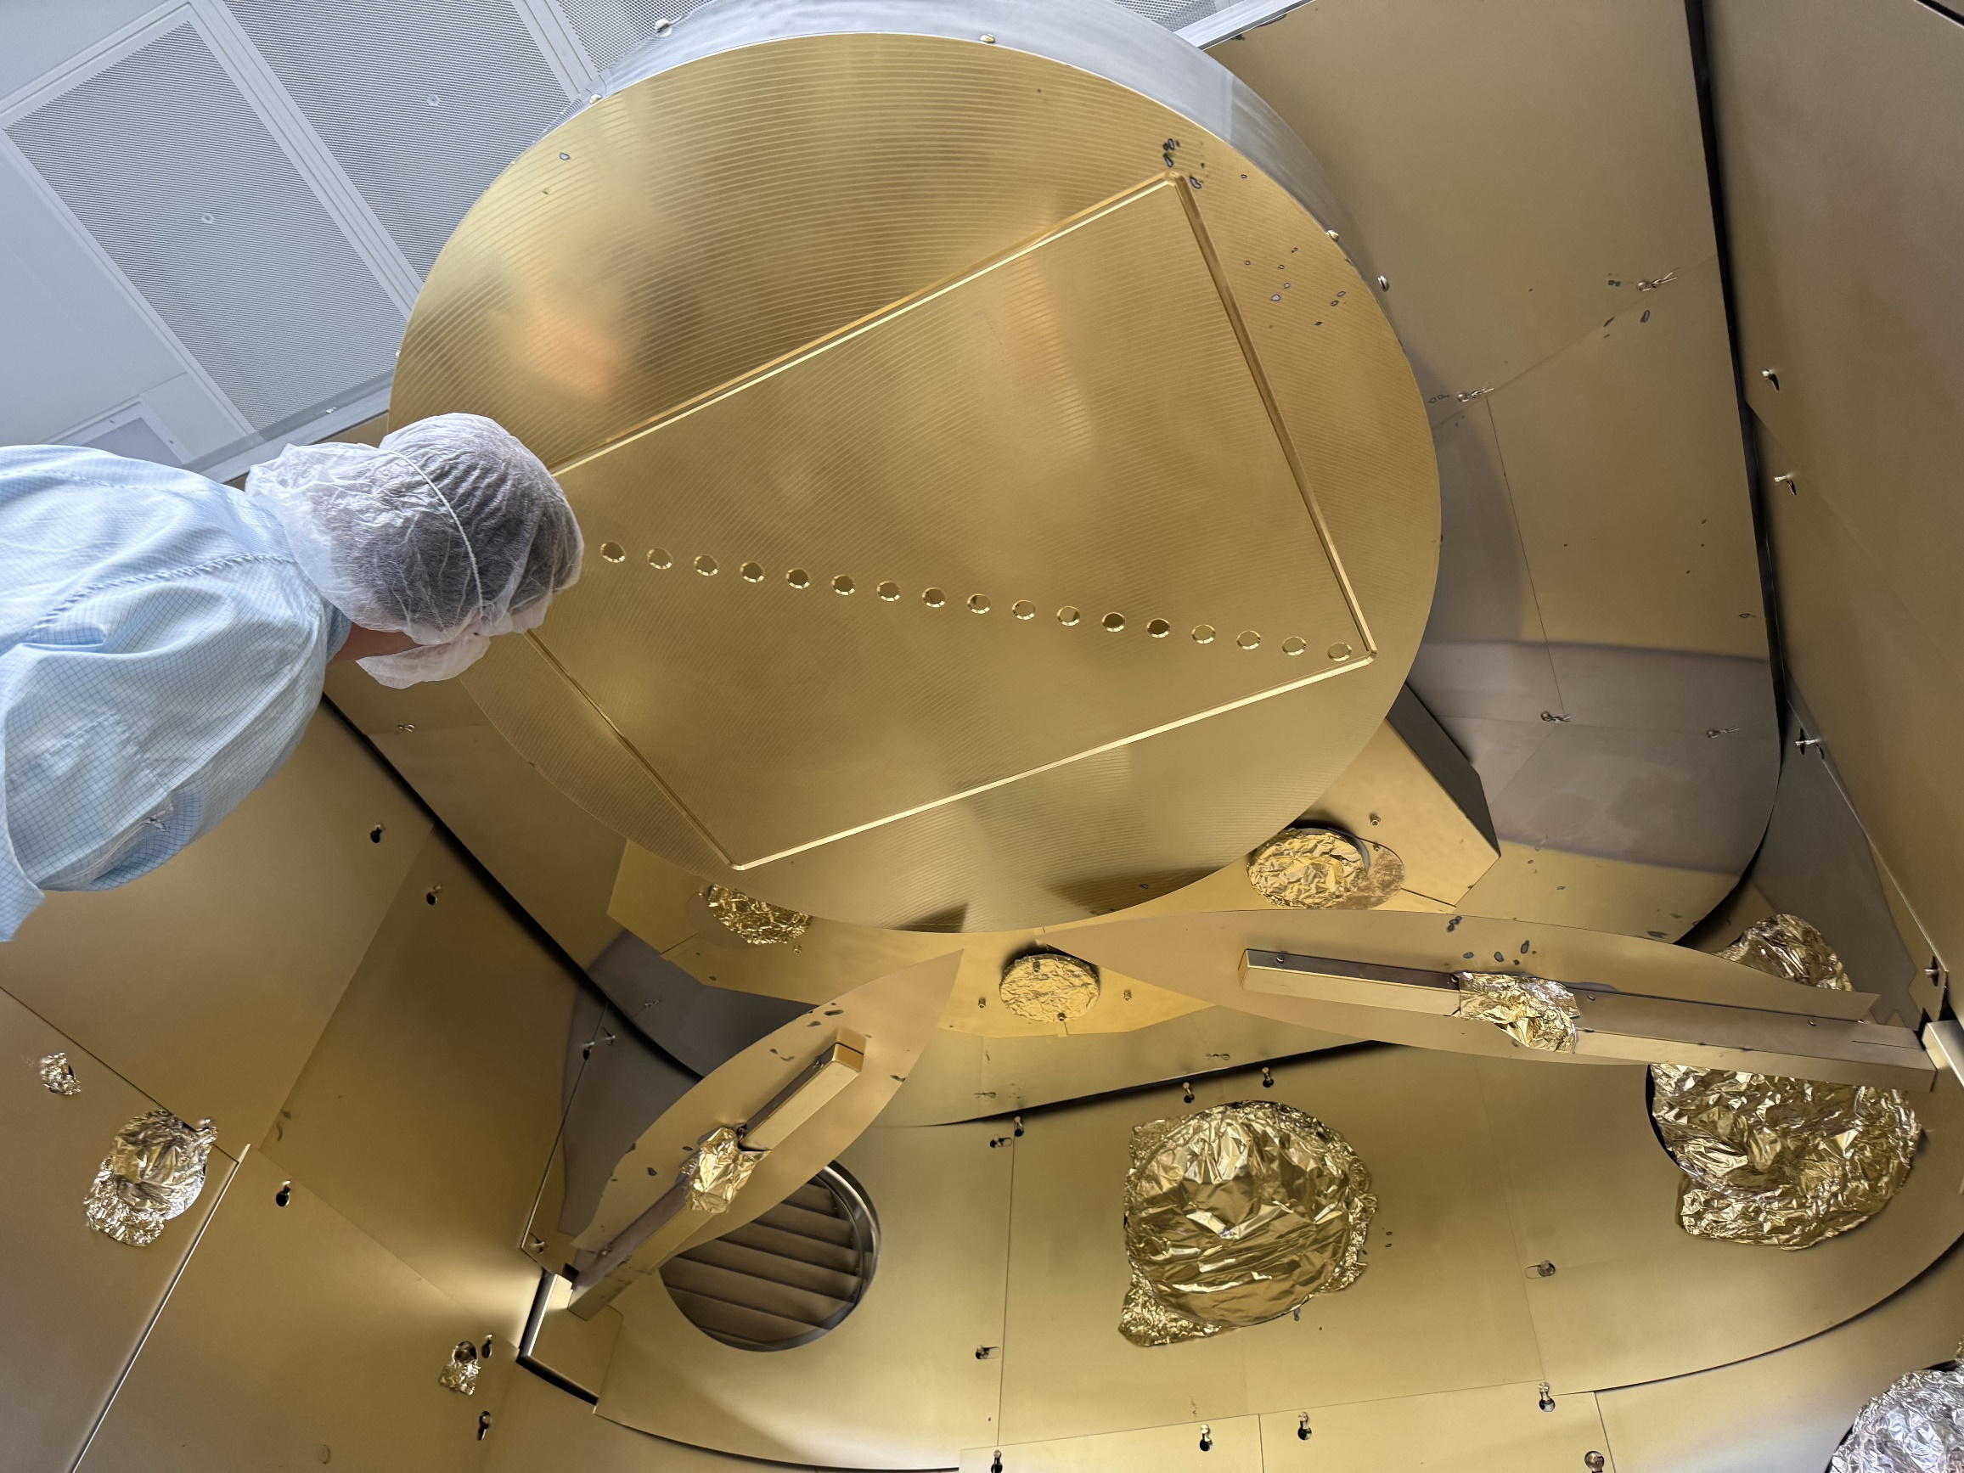
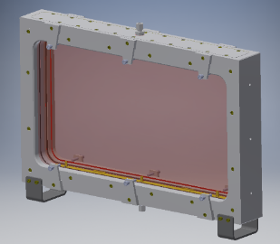
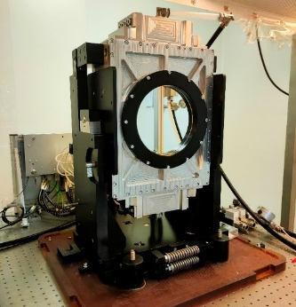
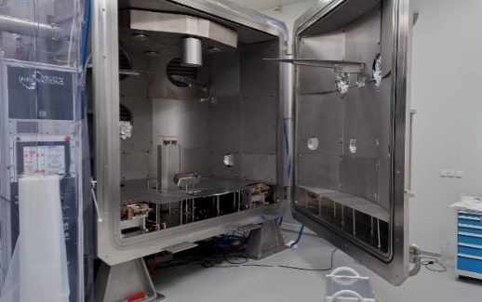










Technology for High-Repetition- Rate Intense Laser Laboratories
EU-funded project under the HORIZON-INFRA-2022-TECH-01 call (01/2023-12/2026)
Goal: Bringing high-energy high-repetition-rate (HEHRR) lasers to the next level
Bottleneck technologies
high-energy actively cooled amplification
scaling by beam combining
real-time wavefront control
capabilities for large optical components in academic environment
system modeling
Output: Towards conceptual designs for lasers at FAIR and Eu-XFEL
Pseudo-Active Mirror Disk Amplifier (Amplitude)
liquid-cooled glass module
ELIAS coating chamber

Slide 4

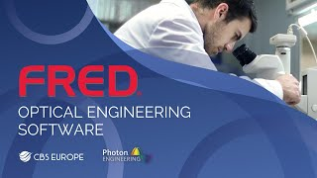




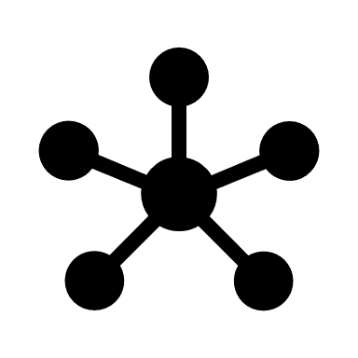


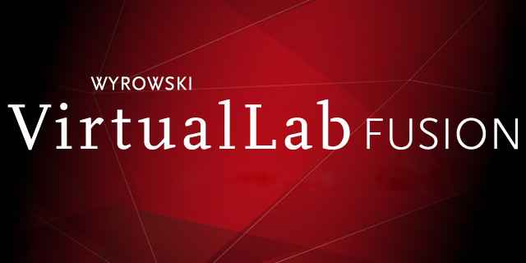



OPOSSUM - Introduction
Modern high-intensity laser systems become more sophisticated & complex
Rigorous planning is crucial to make systems sustainable
Our Approach: OPOSSUM OPen-source Optics Simulation System and Unified Modeler
Open source, accessible for all
Decouple system design from modeling: setup design once, model/analyze in numerous ways
Platform for custom-code integration
Extensible to specific needs
Holistic simulation of large-scale laser facilities
Modern backend, written in Rust for high maintainability, memory safety
Full-scale modeling of these systems, ideally creating a “digital twin” is necessary!
Open Source
However, existing modeling solutions are
Proprietary (closed source):
Hard / impossible to extend, expensive
Self-written codes:
Often „single-use“ during a thesis
Not well maintained, mostly non-compatible with other codes
Targeting specific problems
Custom code integration
Design once,
model often
General
solution
Rust: fast,
memory safe

Slide 5

OPOSSUM - Introduction
Modern high-intensity laser systems become more sophisticated & complex
Rigorous planning is crucial to make systems sustainable
Our Approach: OPOSSUM OPen-source Optics Simulation System and Unified Modeler
Open source, accessible for all
Decouple system design from modeling: setup design once, model/analyze in numerous ways
Platform for custom-code integration
Extensible to specific needs
Holistic simulation of large-scale laser facilities
Modern backend, written in Rust for high maintainability, memory safety
Full-scale modeling of these systems, ideally creating a “digital twin” is necessary!
However, existing modeling solutions are
Proprietary (closed source):
Hard / impossible to extend, expensive
Self-written codes:
Often „single-use“ during a thesis
Not well maintained, mostly non-compatible with other codes
Targeting specific problems
https://git.gsi.de/phelix/rust/opossum

Slide 6
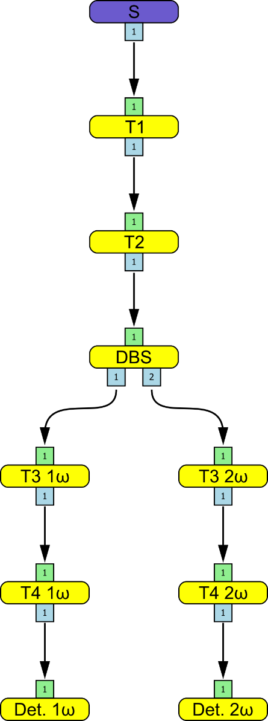

Simulation Principle
Example flow graph
Model arbitrary optical systems as (acyclic) directed graphs
“Light" flowing as data between nodes
Complex system, consisting of similarly complex sub-systems
Optics (lenses, mirrors, setups, custom code…) as nodes
Nodes can store an internal status, e.g. population inversion
Intuitive node positioning/alignment in 3D space
Different analyzer modes

Slide 7
Nodes
Nodes are the building blocks of the optical system
A node holds one or multiple optical interfaces
An optical interface consists of:
A geometrical surface: e.g., plane, sphere, cylinder…
An aperture
A coating: e.g., Fresnel, ideal-AR, specified reflectivity
Laser-induced damage threshold (LIDT) information
Refractive indices after a surface can be handled via:
Constant value
Sellmeier equations
E.g. Lens
Radius
n₁
n₂
Aperture
Coating

Slide 8
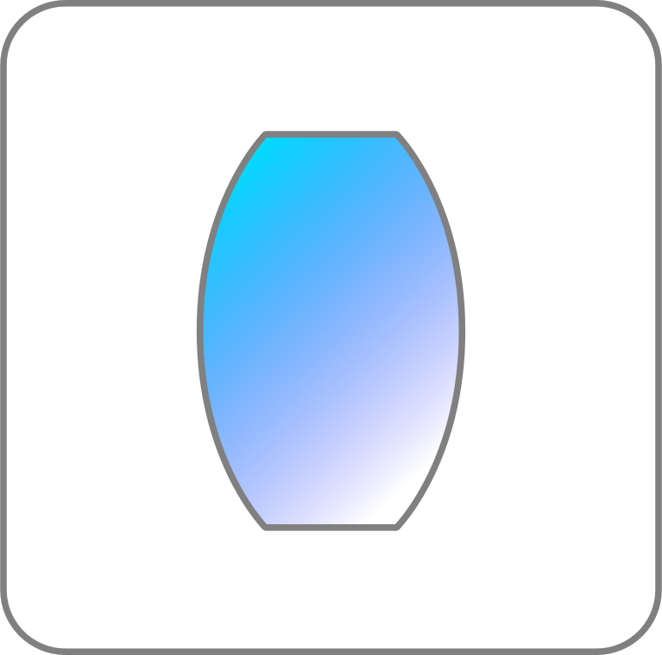
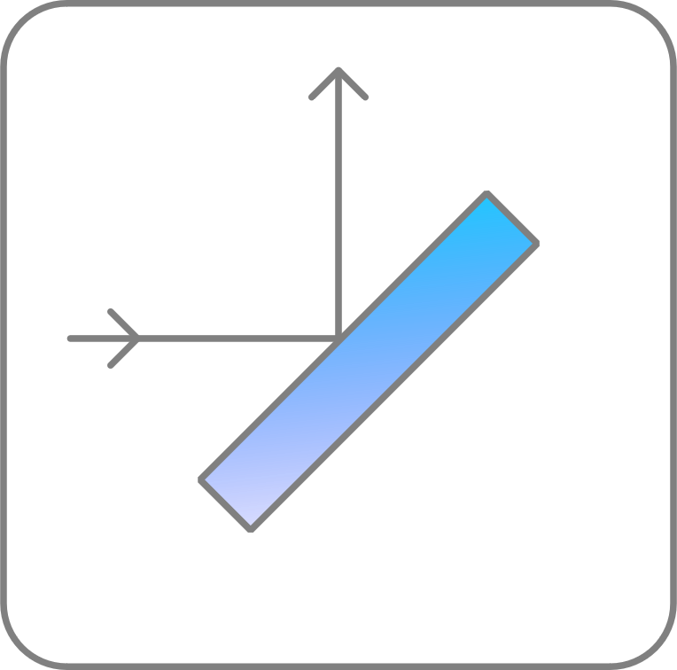

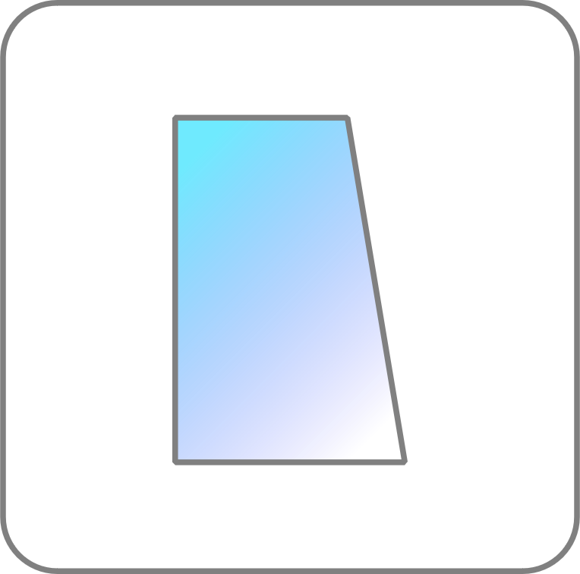
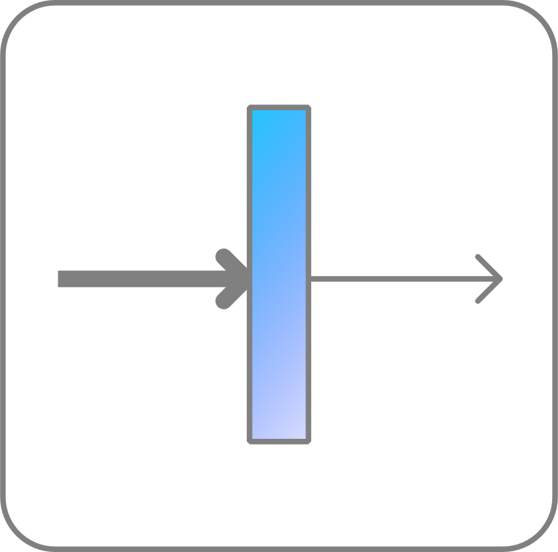
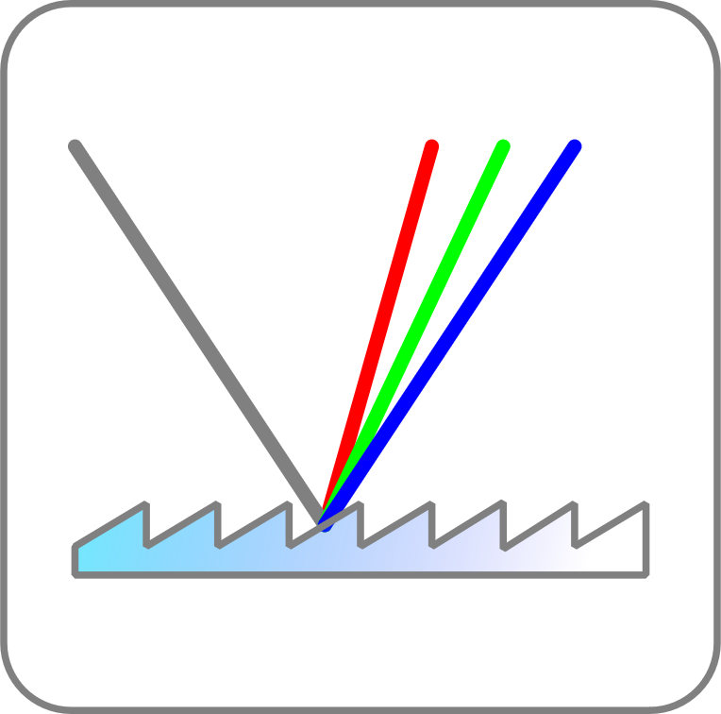
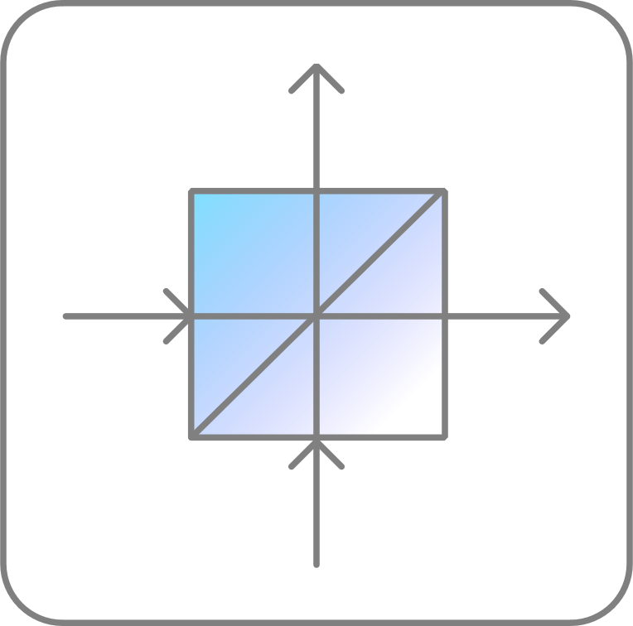
Nodes – Node types
Generic nodes:
Spherical / cylindrical / paraxial lens
Flat / spherical / oap mirror
Wedge
Ideal filter
Reflective grating
Ideal beam splitter

Slide 9
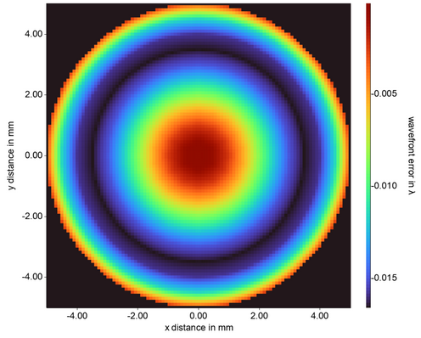
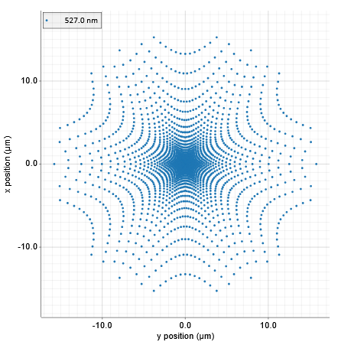
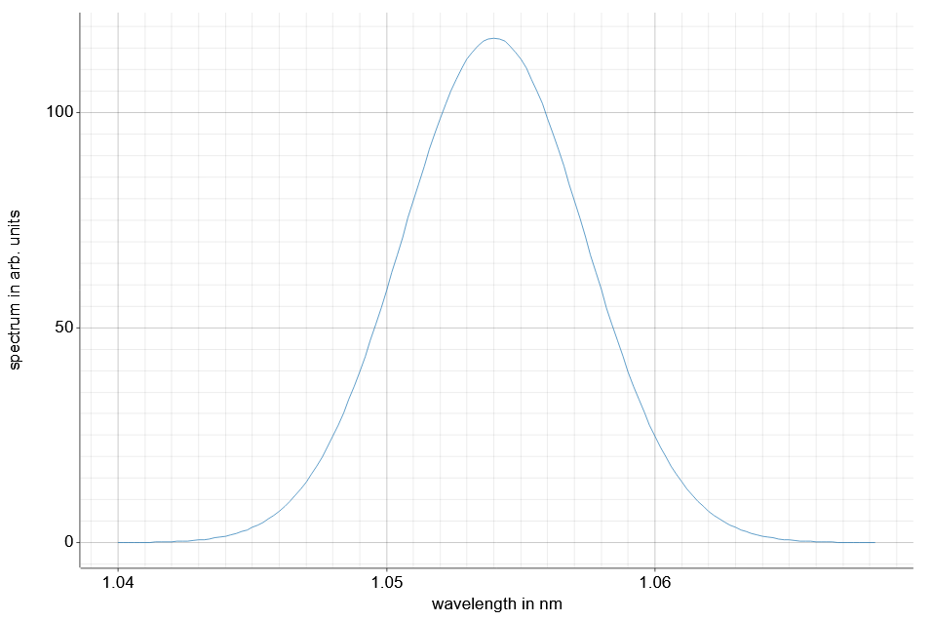
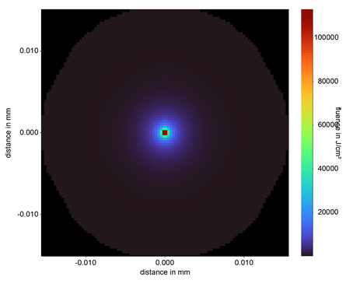
Nodes – Node types
Detector nodes:
Energy
Wavefront
Spot diagram
Spectrum
Fluence
Wavefront
FF Spot diagram
4
2
-5
10
y in mm
0
wavefront error in mλ
y in µm
0
-10
-2
-10
-4
-15
-4
-2
0
2
4
-10
0
10
x in mm
x in µm
Spectrum
FF Fluence
10
100
20
80
y in µm
60
spectrum in arb. u.
0
fluence in kJ/cm²
50
40
-10
20
0
1040
1050
1060
-10
0
10
wavelength in nm
x in µm

Slide 10
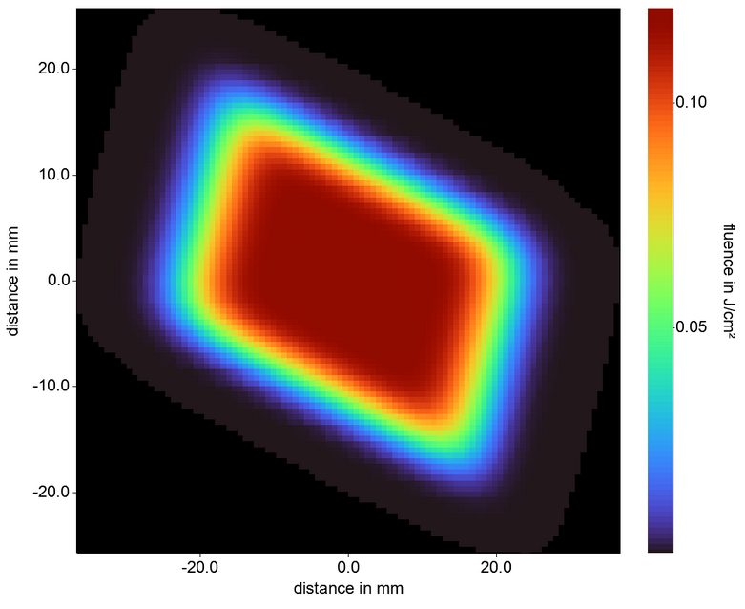
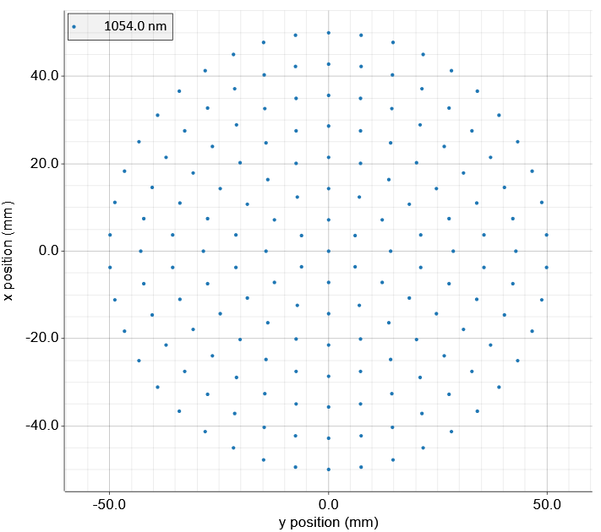
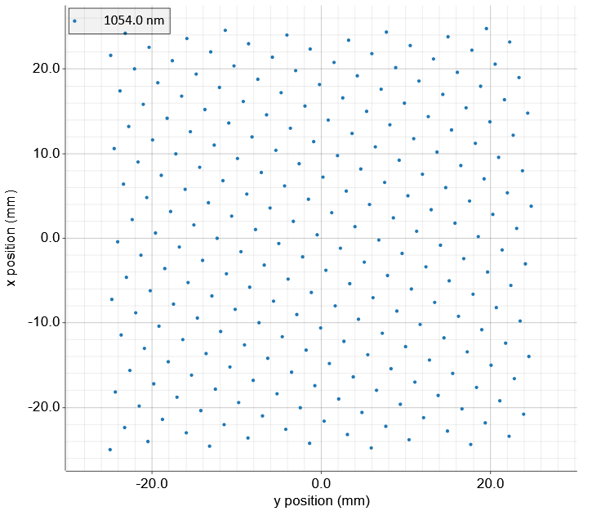
Nodes – Node types
Special nodes:
Source:
Energy / fluence distribution: uniform, 2D Gaussian
Position distribution: hexapolar, Fibonacci, .etc
Shape: ellipse, rectangle
Spectrum: Gaussian, single lines
General 2D Gaussian
Hexapolar positioning
20
0.2
40
10
20
0
fluence in J/cm²
y in mm
0
0.1
y in mm
-10
-20
-20
-40
-20
0
20
-50
0
50
x in mm
x in mm
Rectangular shape
Spectrum
20
20
10
0
y in mm
spectrum in arb. u.
50
-10
-20
0
-20
0
20
1040
1050
1060
x in mm
wavelength in nm

Slide 11
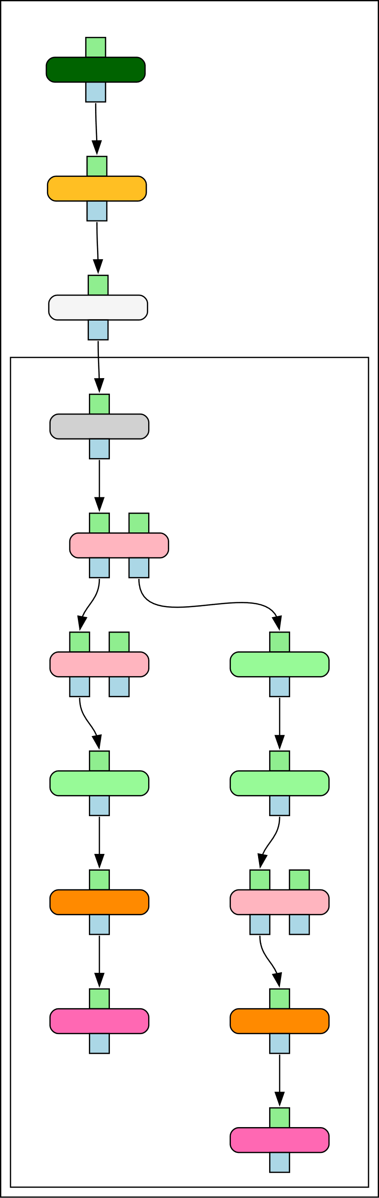
Nodes – Node types
Special nodes:
Source:
Energy / fluence distribution: uniform, 2D Gaussian
Position distribution: hexapolar, Fibonacci, .etc
Shape: ellipse, rectangle
Spectrum: Gaussian, single lines
Nodegroup
Allows grouping of nodes / subsystems
Infinite nesting possible (groups in groups …)

Slide 12
Nodes – Node types
Special nodes:
Source:
Energy / fluence distribution: uniform, 2D Gaussian
Position distribution: hexapolar, Fibonacci, .etc
Shape: ellipse, rectangle
Spectrum: Gaussian, single lines
Nodegroup
Allows grouping of nodes / subsystems
Infinite nesting possible (groups in groups …)
Reference nodes
Effective re-using of nodes
Considers internal status
Example: Double-pass amplifier
λ/4
Mirror (M)
Beam splitter (BS)
Active medium (AM)
Flow-graph:
BS
AM
λ/4
M
Ref λ/4,
Inv.
Ref AM,
Inv.
Ref BS,
Inv.

Slide 13



Node Geometry / Positioning
How to define a node position in 3D space?
„Conventional“ approach (ZEMAX, Code V, OSLO,…)
Using absolute coordinates
Using coordinate breaks
OPOSSUM approach
Use relative positioning through calculation of an optical axis
Most optical systems easy to model
Absolute positioning still possible
Needs to check for inconsistencies
non flexible (but sometimes necessary)
may cause headaches for complex designs

Slide 14
Node Geometry / Positioning
Position first node (typ. source) absolutely in 3D space
y
S
z

Slide 15
Node Geometry / Positioning
Position first node (typ. source) absolutely in 3D space
Define relative distance to next node along the current optical axis
y
100 mm
S
z

Slide 16
Node Geometry / Positioning
Position first node (typ. source) absolutely in 3D space
Define relative distance to next node along the current optical axis
y
Define local orientation of node (tilt, decenter of anchor point)
100 mm
Define relative distance to next node along the current optical axis
S
z
Repeat

Slide 17
Analyze your optical setup
E₁
E₂
E₃
Simple energy analyzer
Energy flow between nodes
Rudimentary but very fast
Sequential ray-tracing analyzer:
Rays propagate from node to node guided along a topologically sorted flow-graph
Parameters such as fluence, energy, wavefront accessible via detector nodes
Semi-sequential ghost-focus / LIDT analyzer
Rays propagate similar to ray-tracing analyzer but can bounce off of surfaces
Iterative for- and backward propagation
Report for optics on which the fluence exceeds LIDT
Node 1
Node 2
Node 3
Rays₁
Rays₂
Rays₃
Node 1
Node 2
Node 3
Iteration 1: forward
Node 1
Node 2
Node 3
Iteration 2: backward
Node 1
Node 2
Node 3
Iteration 3: forward…

Slide 18
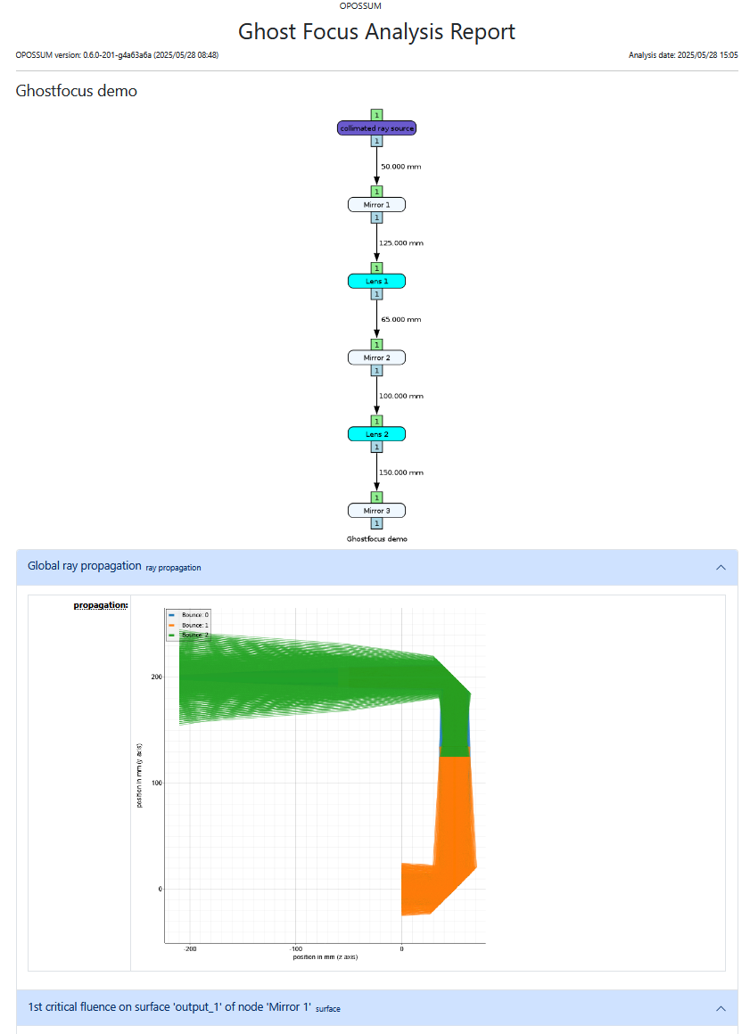
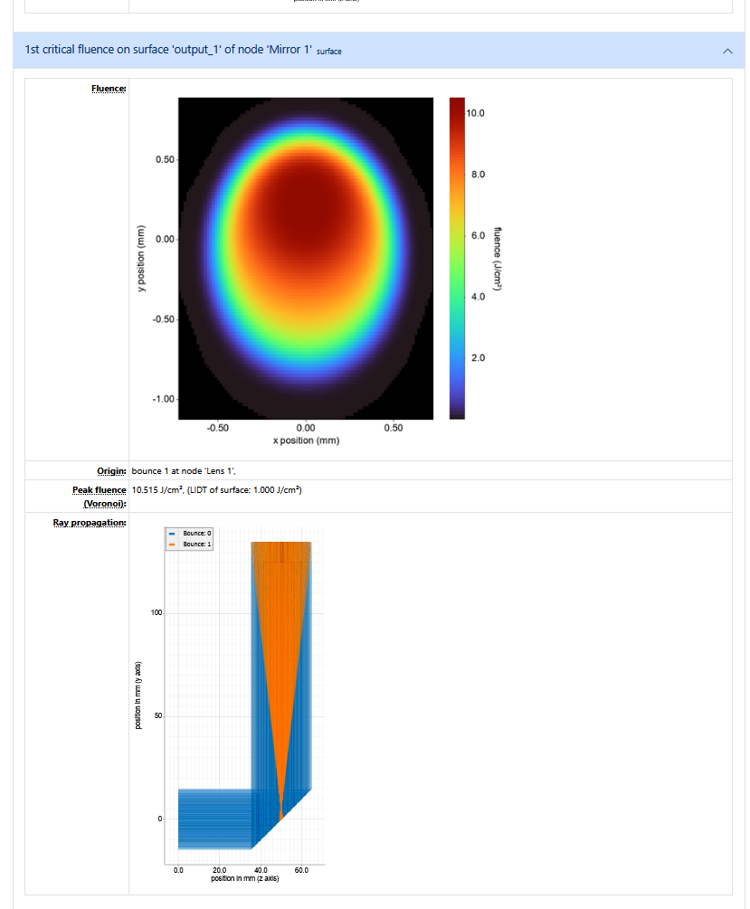
Reports
Reports are generated as HTML to be viewed in a web browser
Format is analyzer dependent
Example: ghost focus analyzer
Global plot
LIDT-specific data → damaged optic → information about origin of damaging beam → fluence values on optic

Slide 19
outline
Introduction THRILL / OPOSSUM
Overview OPOSSUM
OPOSSUM Ecosystem
Simulation examples
Outlook / User Feedback

